Slide 1
UAV and UAV Controller Authentication and Communication Security
Abhinav Kumar
2019CS50415

Slide 2
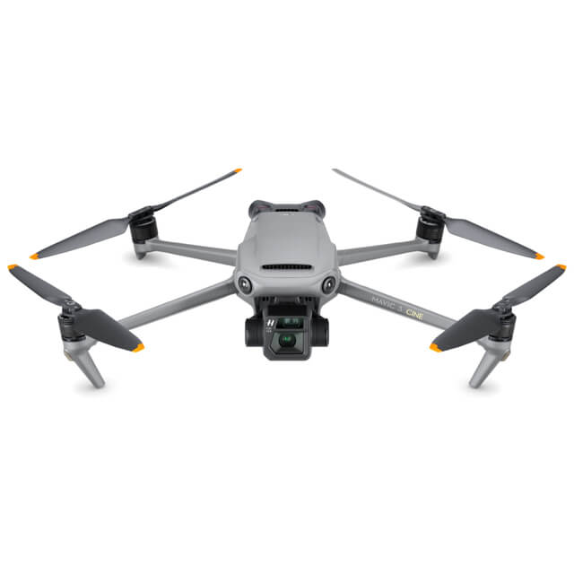
Drones(UAVs)
Vehicles that are controlled remotely from a Ground Control Station (GCS) or autonomously by a programmed mission
There are difference types of UAVs based on
payload
flying mechanism
range and altitude
speed
flight time and power supply
There are two main purposes of drones
Commercial usage
Military usage
Page No: 1

Slide 3
Motivation
Wide range of use
Several interesting projects are going on
VirusCopter
Facebook Aquila and Google Loon
UAVs can be connected to cellular networks as new types of user equipment
UAVs are becoming more prone to security attacks
The wireless communication channel opens up the door for several types of remote attacks
Page No: 2

Slide 4
Goal
To carry out a security analysis of the MAVLink protocol
Create a simulated environment of UAV and UAV controller
Try illegally connecting to drone and sending message when already a real user is connected
The MAVLink protocol specifications such as the different messages and message structure have been examined
Page No: 3

Slide 5
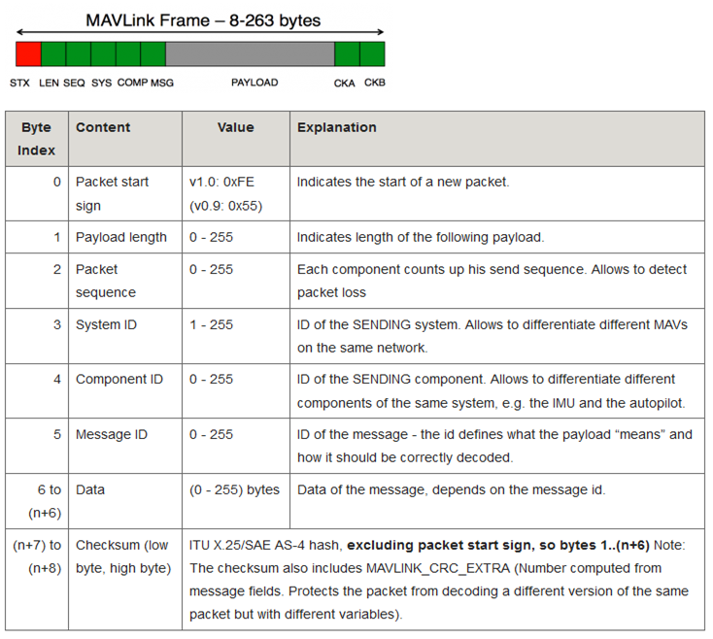
MAVLink Protocol
A very lightweight messaging protocol for communicating between UAV and GCS
The protocol defines a large set of messages
A message is sent bytewise over the communication channel, followed by a checksum for error correction
Message types are identified by the ID field on the packet
Page No: 4

Slide 6
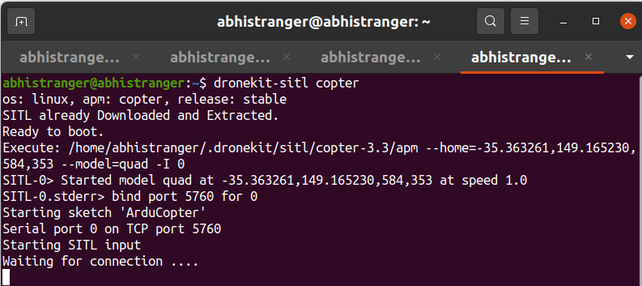
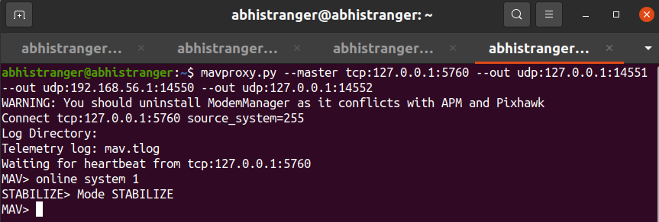
Methodology
We used a simulator from the SITL environment, providing a virtual drone with the GCS
Starts copter at home location with speed 1m/s
Provide TCP port 5760 for connection
SITL is used in combination with a GCS, like MAVProxy
Connects to the Copter
Provides 3 UDP port for our use which we can connect to drone
Page No: 5

Slide 7
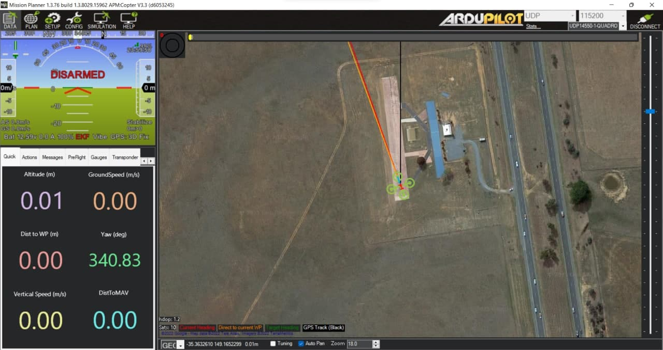
Methodology Contd…
We used Mission Planner for the GUI connected via UDP port 14450
Real user will be connected via UDP port 14451
Attacker user will be connected via UDP port 14452
Used wireshark to capture the messages sent
Page No: 6

Slide 8
Implementation
Two ways of communicating to the drone
pymavlink
Dronekit
First thing we need is to connect to the drone
By pymavlink:
master = mavutil.mavlink_connection('service protocol :IP ADDRESS:PORT')
By Dronkit:
vehicle = connect('IP_ADDRESS:PORT_NUMBER', wait_ready=True)
We can use master or vehicle to send messages to the drone
Page No: 7

Slide 9
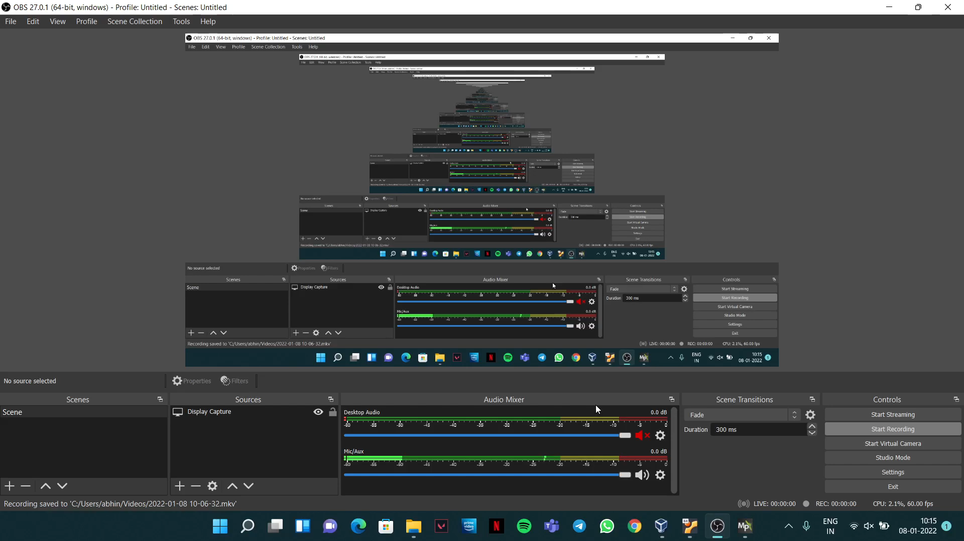
Demo
Page No: 8

Slide 10
Results
Able to identify a possible security flaw
Able to stop the drone for some second and was able to change the speed by one attacker file
Able to stop the drop for a long time and when it again come back it was on a different location which was far from the location at which it stopped by another attacker file
This shows that we can send a command without being a legitimate user
Page No: 9

Slide 11
Conclusions and Future Works
Conclusions:
MAVLink has found to have security vulnerability
A attacker can easily send messages and get control over it
A lot of work has to be done to make MAVLink more secure
Future Works:
This work can be repeated on real drone
Confirming the attack by using mavlink version 2
Exploring the attack with more types of messages
Finding the solution to prevent this type of attack
Page No: 10

Slide 12
Challenges Faced
Very few resources available
Not able to find how to use mavlink v2
Page No: 11

Slide 13
Thank You

